Slide 1
Coding Divas - Women HackTech Team Id # 20 SynShip - Deliver Easy… Deliver Fast… Crowd Sourced Last Mile Delivery Solution Chandravadhana TK Gayatri Buche Sanketa Kadne Selva Priya
March 2018

Slide 2
Table of Contents
1 | Use Case
2 | Solution
3 | Technical Design
4 | Innovation
5 | Business Value
6 | Relevance
7 | Reusability
8 | Technology
9 | Value
10 | Savings

Slide 3
Use Case: Crowd Sourced Last Mile Delivery
Problem Statement | Scope
Optimizing Last mile delivery is a burning challenge for all the retailers and logistics players. For achieving optimal operations efficiency, market players are exploring crowd sourced operations management. | In-Scope: Driver Portal & Management Admin Portal Transport Manager Portal Out-of-Scope: Other Stakeholder’s (Admin, Transport Manager, Finance Manager) Management Finance Manager Portal
Goal Statement | Business Case / Impact
Unique crowd-based delivery for B2C parcels: Solution to facilitate retailers to deliver the shipments to customers through the registered freelance drivers and manage based on driver performance. | Faster Delivery Low Cost Personalization Access to new Products Flexible delivery in time and location

Slide 4
Solution
Num. | Use Case | Functionality | Solution Approach | Priority
1 | Login/ Register for Drivers | First time drivers can register to the system. Registered drivers can login into the system. | New users with valid license and vehicle for Shipments can register as Drivers Driver users can login with registered email/username and password or fingerprints Admin users can login with registered email/username and password or fingerprints. Transport Manager users can login with registered email/username and password or fingerprints. Finance Manager users can login with registered email/username and password or fingerprints. | Medium
2 | Role Based Access | There are 4 roles: Driver Transport Manager Admin Finance Manager | Driver can view Scheduled Deliveries Driver can bid for Scheduled Deliveries Driver can automatically update Shipment Transit Status Driver can update Shipment’s Delivery Status Driver can acknowledge Payment Process Driver can manage his Personal Profile Transport Manager can add, update, delete Schedule Deliveries Transport Manager can approve for Payment after Shipment is complete Admin can approve, reject, verify driver and activate/deactivate driver accounts Admin can rate the drivers based on Shipment Qualiity Finance Manager can initiate Payment Process | Medium

Slide 5
Solution
Num. | Use Case | Functionality | Solution Approach | Priority
3 | Driver DashBoard | Participate in auctions Ships and gets paid, if winning the bid Rates the Shipment delivery Manages his own Profile | View the Scheduled deliveries Select shipments that can be delivered with the quoted rates. Bids Scheduled deliveries. View Pending Delivery Queue with details like Pickup Location Delivery Location Weight and Dimensions Special Requests (cold storage required? Etc.) Receive a notification once the retailer (Transport Manager)accepts freelancing request upon rates negotiations and finalization. Update status depending on the pickup, delivery or return of consignment Rates the Driver, based on Shipment Quality – Delivery Ratings. Upon completing the scheduled delivery tasks the driver gets paid. Payment notification is received on mobile app. History of assigned tasks, completion, payments, disputes, etc. can be accessed by the user from his account. | High

Slide 6
Solution
Num. | Use Case | Functionality | Solution Approach | Priority
4 | Transport Manager Dashboard | Schedules Delivery Owns the Bidding Process from Start till Payment initiation | Manages and Updates the Dispatch Queue. Schedules Delivery with details like Pickup Location Delivery Location Weight and Dimensions Special Requests (cold storage required? Etc.) Initiates the Auction for the Scheduled Deliveries . Receives notification for the expression of interest from driver against deliveries. Negotiations on rate and terms & conditions is performed and the task is confirmed. Selects the bidding winner based on Driver's quotes, Driver Ratings from Admin and Track Records. Upon completion of delivery approves the line item to be further processed by finance team for payment disbursement. | High
5 | Finance Manager Dashboard |  | Dispatches Payments to the Drivers Sends SMS alerts to the Drivers Updates Payment Status in the System | High

Slide 7
Solution
Num. | Use Case | Functionality | Solution Approach | Priority
6 | Admin Dashboard | Driver Background Verification Driver Account Activation/Deactivation | Approve Driver accounts after background verification Activate accounts and send email notifications and SMS Alerts Assign accesses to view Dispatch Queue Rates the Driver, based on Shipment Quality – Admin Ratings. Based on the delivery success driver rating is maintained in the system and best performers are incentivized. | High
7 | Automated Emergency Support | SoS Helpdesk Support | On click, alert SoS (Save our Soul) configured focal. If SoS is not available, alert the Transport Manager who assigned the Scheduled Delivery and call ambulance and notify location. Call Helpdesk support for any general queries. | Medium

Slide 8
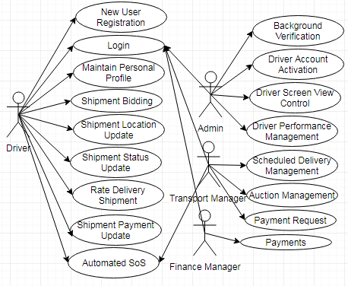
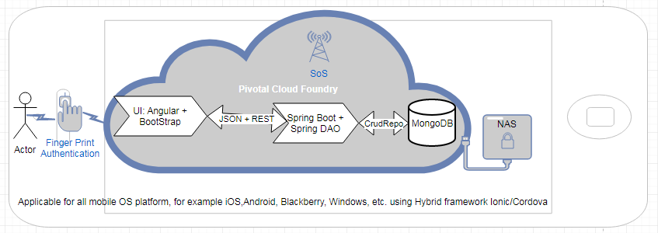
Technical Design: Use Case and Deployment Solution
*Note: Diagrams drawn with UML Tool SmartDraw Trial version

Slide 9





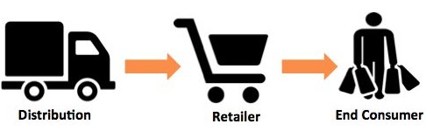
Innovation - Single Stop Solution
Dashboard
Multi Dimensional
Location Sensor
Mobile Solution
Analytics
Retailers + Transportation + Logistics

Slide 10
Innovation
Dashboard
The driver can log into the application using fingerprints
Multi Dimensional
Automated Emergency Support
Location Sensor
Driver interface internally updates Shipment’s live route status, emergency alerts and any delivery slippages to the system.
Maps notifies the re-planned optimized route to the driver and transport manager.
In case of trip deviation, the route planner re-plan the trip and notify the optimized route to the driver and transport manager.
In case of weather emergency, re-plan/re-optimize the route plan and notify the driver and transport manager of the re-planned route.
Mobile Solution
Download and use the App
Analytics
Derived Driver Rating from Admin and Driver Feedbacks

Slide 11
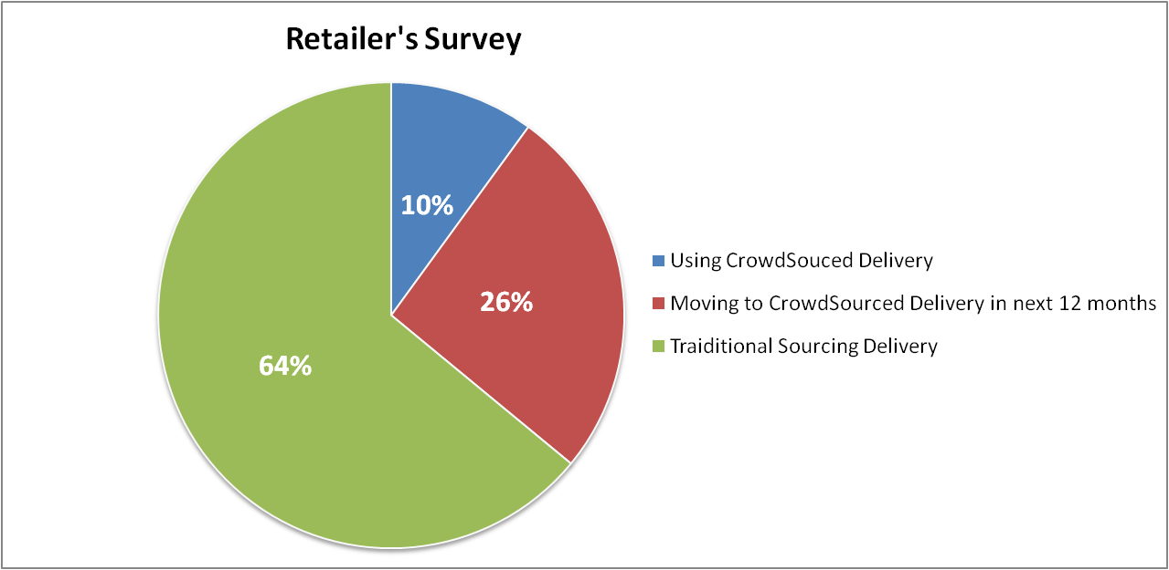
Business Value
Good Growing Market to Capture. 28% of total delivery cost to a transportation and logistics company is accrued in the last mile delivery process. By 2026, the market is forecast to be $10.9 billion, with software representing nearly $8.7 billion
Has the potential to become an IP if done on a large scale business case
Easily customizable
Faster communication

Slide 12
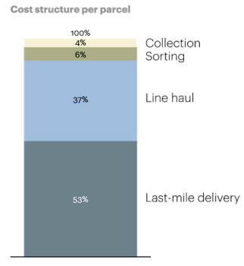
Relevance
28% of total delivery cost to a transportation and logistics company is accrued in the last mile delivery process.
53% is the Last mile delivery cost of the total cost per Parcel/Shipment.
Online Solution will aid huge savings.

Slide 13
Reusability
S.No | Module | Reusable Domains | Reusable Projects | Reusable Verticals
1 | Login/Registration Web service | All Domains | All/Any project that requires login and registration | All Verticals
2 | Emergency Service | Medical Domain | Life saver projects Medical projects | Medical Vertical Supply Chain Vertical
3 | Location Sensor | Transportation Domain Logistics Domain | Transportation projects Supply Chain Management Projects | All Verticals
4 | Login/Registration Web service for Mobile Applications | All Domains | All/Any project that requires login and registration | All Verticals
5 | Location Sensor Services for Mobile Applications | Transportation Domain Logistics Domain | Transportation projects Supply Chain Management Projects | All Verticals
*Note: This Route Optimizer Mobile application solution is reusable, which can be applicable for all mobile OS platform, for example iOS, Android, Blackberry, Windows, etc. using Hybrid framework Ionic/Cordova
Notes:
Describe how your solution can be reused across domains, verticals or projects?

Slide 14
Technology

Slide 15
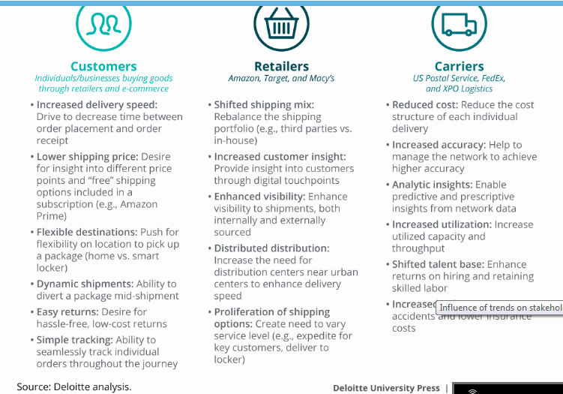
Value

Slide 16
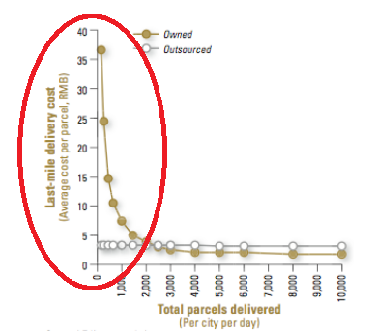
Savings
Last mile delivery cost is higher
When the process is faster, the saving is higher.

Slide 17
Thank You!

